Slide 1
Kubernetes
"kernel" of distributed systems
Notes:
1

Slide 2
"kernel" of distributed systems

Slide 3
Installation
Kubeadm
Kubernetes Operations (kops)
Kubicorn
Hard way
Notes:
Kubernetes is an orchestration tool which allow us to run manage container based workloads.
3

Slide 4






K8 Architecture
Controller
kube-proxy
Notes:
4

Slide 5
Kube API server
Client Authentication
Interface to external world
Validate the request
Update ETCD, scheduler and kubelet
Notes:
5

Slide 6
ETCD Cluster
Stores configuration information
Highly available Key value store
Distributed among multiple nodes.
Accessible only by API server
Has sensitive information.

Slide 7
Controller Manager
Controller
Node Controller
Control loop that watches the shared state of the cluster
Replication Controller
Endpoint Controller
Regulates Kubernetes cluster
Service Account and Token Controller
Manages lifecycle functions

Slide 8
Scheduler
Stores resources usage about each node
Schedules the tasks to worker nodes
Quality of Service
Affinity

Slide 9

Worker components
kube-proxy
PODS are running as per PodSpec provided by API server
Manages the Networking in the node

Slide 10
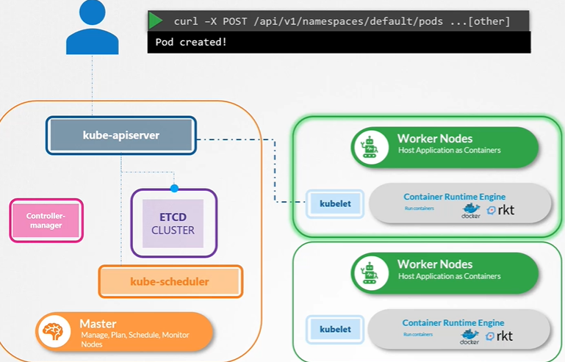
K8 Architecture

Slide 11
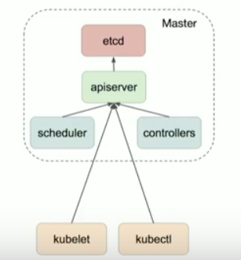
Kubernetes Cluster

Slide 12
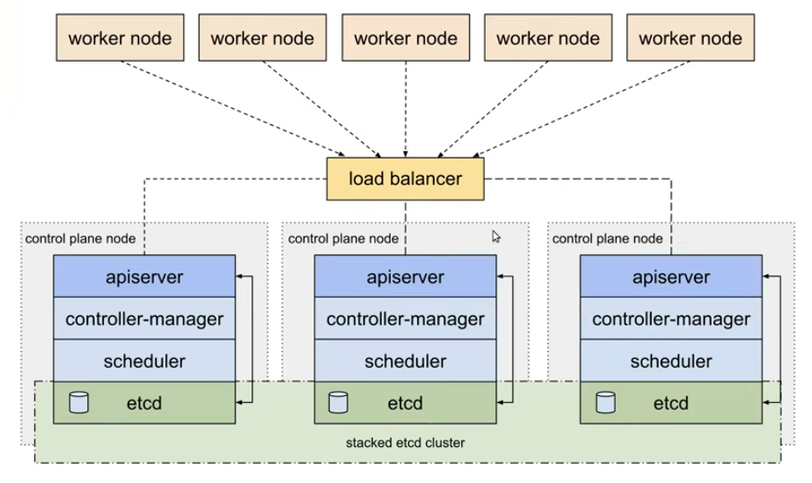
High Availability

Slide 13
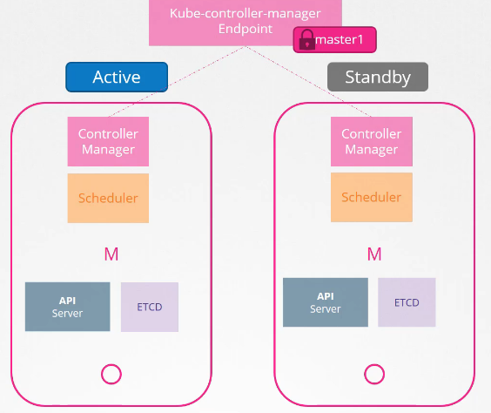
Scheduler/ Controller
Active – Stand by

Slide 14



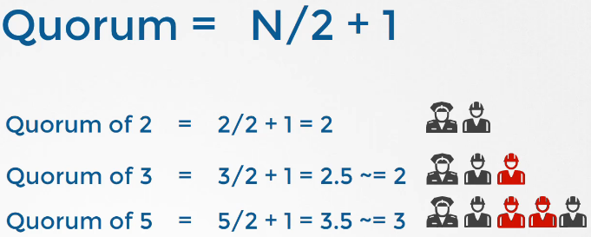

ETCD

Slide 15
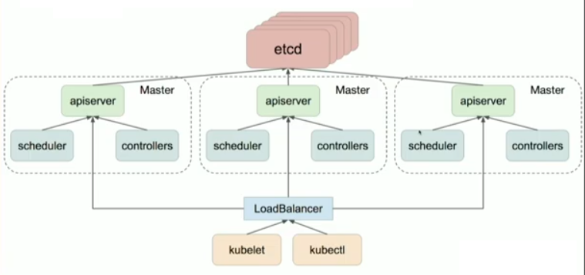
High Availability

Slide 16
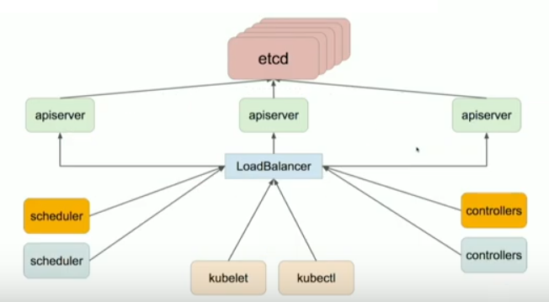
High Availability

Slide 17
High Availability

Slide 18
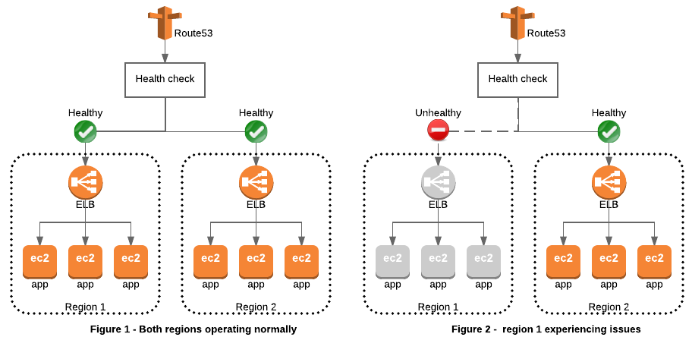
High Availability

Slide 19









HOW IT WORKS ?

Slide 20
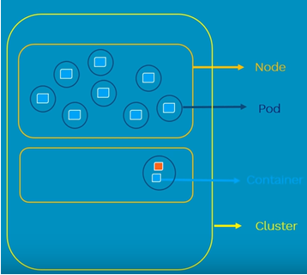
POD
Atomic unit of scheduling
Can have one or more container

Slide 21
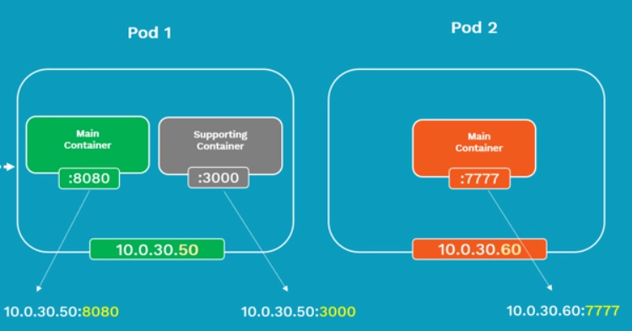
POD
Each POD will have a Pod IP address
Containers inside a POD share same network namespace
Containers inside a POD can communicate using localhost

Slide 22
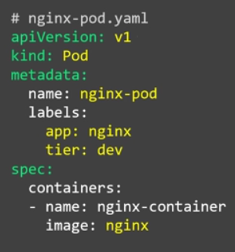
POD
kubectl create –f nginx-pod.yaml
kubectl get pods -o wide

Slide 23
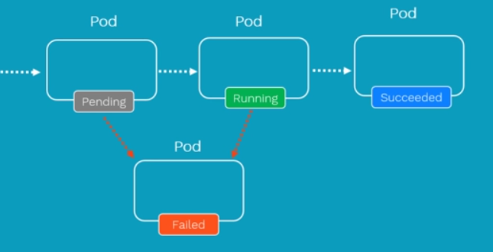
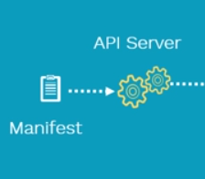


POD Lifecyle

Slide 24
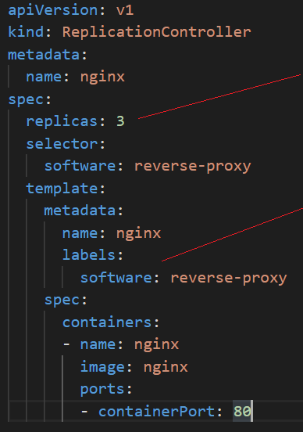
Replication Controller
Ensure that specified number of PODs are running at any point in time
If PODs fail, new ones are created to match the number
ReplicationController and POD is associated using labels

Slide 25
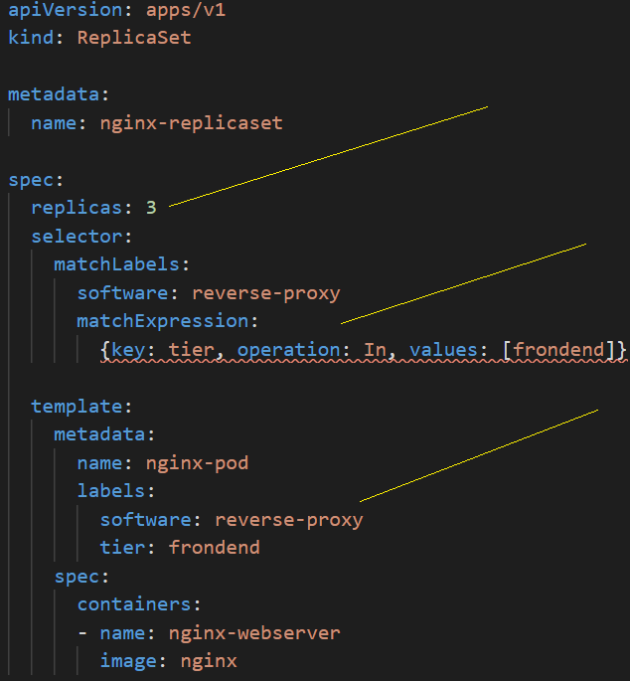
ReplicaSet
Ensure that specified number of PODs are running at any point in time
If PODs fail, new ones are created to match the number
ReplicationController and POD is associated using labels. Match is performed using set based operator

Slide 26
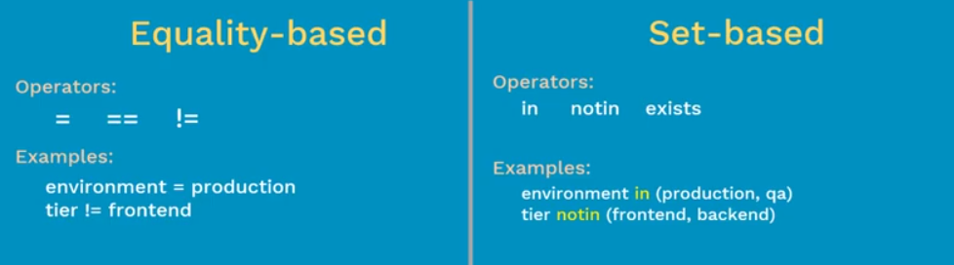
Replication Controller v/s and ReplicaSet
ReplicationController
ReplicaSet

Slide 27
kube-apiserver
Function
Flags
Description
Recommendation
Throttle API requests
--max-requests-inflight
This flag will limit the number of API calls that will be processed in parallel, which is a great control point of kube-apiserver memory consumption. The API server can be very CPU intensive when processing a lot of requests in parallel.
With the latest Kubernetes release, they provide more fine-grained API throttling mechanisms with "--max-requests-inflight" and "--max-mutating-requests-inflight"
Adjust this value from the default (400) until you find a good balance. If it is too low, you will see too many request-limit-exceed errors. If it is too high, you will see
kube-apiserver getting OOM (Out Of Memory) killed because it is trying to process too many requests in parallel.
Generally speaking, 15 parallel requests per 25~30 Pods is sufficient.
Control memory consumption
--target-ram-mb
This value is used for kube-apiserver to guess the size of the cluster and to configure the deserialize cache size and watch cache [9] sizes inside the API server.
The kube-apiserver uses the same assumption as the above mentioned Kubernetes benchmark: 120GB for ~ 60,000 Pods, 2000 nodes, which is equivalent to 60MB / Node, and 30 Pods on each node.
Generally speaking, 60MB per 20~30 Pods is a good assumption to make.
Container memory request can be set to equal to or greater than this value.

Slide 28
kube-controller-manager
Function
Flags
Description
Recommendation
Control level of parallelism
--concurrent-deployment-syncs
--concurrent-endpoint-syncs
--concurrent-gc-syncs
--concurrent-namespace-syncs
--concurrent-replicaset-syncs
--concurrent-resource-quota-syncs
--concurrent-service-syncs
--concurrent-serviceaccount-token-syncs
--concurrent-rc-syncs
Kube-controller-manager has a set of flags that can provide fine-grained controls of parallelism. Increasing parallelism means Kubernetes will be more agile when updating specs, but also allows the controller manager to consume more CPU and memory.
In general, increase settings for components you use more intensively. For larger clusters, feel free to increase default values as long as you are OK with its memory usage. For smaller clusters, if you are tight on memory, you can lower the settings. Kubernetes default values can be found in the kube-controller-manager documentation.
Control memory consumption
--replication-controller-lookup-cache-size
--replicaset-lookup-cache-size
--daemonset-lookup-cache-size
This set of flags is not documented but still available for use. Increasing look up cache size can increase sync speed of corresponding controllers, but will increase memory consumption for controller manager. In practice, we set memory request for controller manager container to be greater than the sum of these 3 values. Note that after Kubernetes 1.6, replication controller, replica set and daemonset no longer require a lookup cache so these flags are not needed. The default values (4GB for Replication Controller, 4GB for Replica Set and 1GB for Daemon Set) works fine for even large workloads. You can tune these values down for smaller clusters to save memory.
Set the container's memory request to slightly greater than the sum of these values.
Throttle API query rate
--kube-api-burst
--kube-api-qps These 2 flags set normal and burst rate that controller manager can talk to kube-apiserver. We increase these values with larger Applatix cluster configs. Default values work pretty well (20 for QPS and 30 for burst). Increase these values for large, production cluste

Slide 29
Google Cloud
Google Cloud
5 worker nodes → n1-standard-1 master nodes
500 worker nodes → n1-standard-32 master nodes
Amazon Web Services
5 worker nodes → m3.medium master nodes
500 worker nodes → c4.8xlarge master nodes
500 worker nodes, the used master nodes have 32 and 36 CPU cores
120 GB and 60 GB of memory.

Slide 30
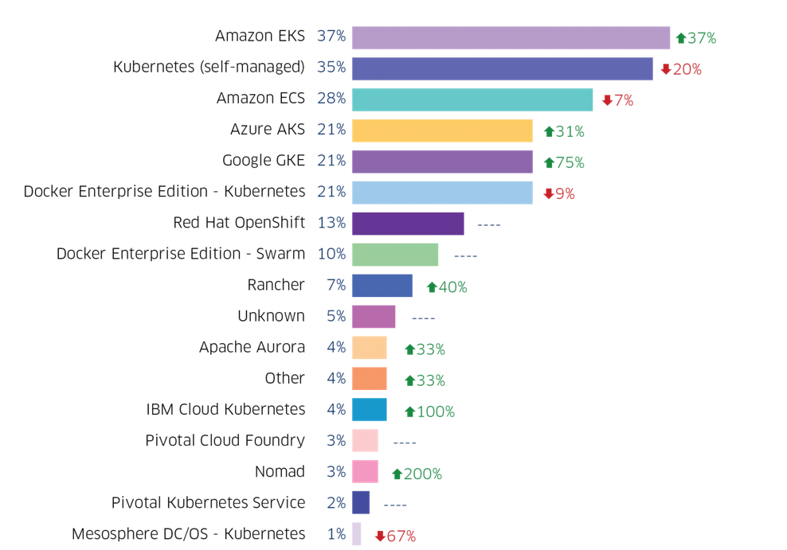
Kubernetes Adoption

Slide 31
Openshift
For production environments, the following recommendations apply:
Master Hosts
1 CPU core and 1.5 GB of memory for each 1000 pods.
Recommended size of a master host in an OpenShift Container Platform cluster of 2000 pods would be the minimum requirements of 2 CPU cores and 16 GB of RAM, plus 2 CPU cores and 3 GB of RAM,
Total 4 CPU cores and 19 GB of RAM.

Slide 32
Kubernetes Cluster – Control Plane
Etcd - Two-Four CPU cores are enough and disk I/O will be far more critical; therefore, making sure the fastest disks available are used.
Small etcd cluster serving under 200 Kubernetes nodes will be three servers with two cores each, 8GB of RAM, 20GB of disk space per node (greater than 3000 concurrent IOPS)
API Server - Four CPU cores and 16GB of memory
On small clusters with under 100 nodes, the control plane will fit into the unused capacity from the etcd cluster as long as the nodes have
Each instance can only handle a set number of requests at a time which defaults to 400.

Slide 33
Kubernetes Cluster – Data Plane
Worker Nodes :-
Assume the average pod will have a requested memory of 256Mb.
3000 pods will require 750GB of total memory across all the nodes, plus the 1 GB of base per-node memory already required (kubelet, plus the three DaemonSets listed above).
On AKS, each of the 112 nodes would need 8GB of RAM at the absolute minimum. But GKE or OpenShift (with 100 pods per node as the default limit) would have 31 nodes with 26GB of RAM minimum.

